Slide 1
FYP Proposal Defense <<Builder Management System>>
GROUP MEMBERS
S.No. | Enrollment # | Student Name
1 | 02-131212-009 | Muhammad Shoaib Akhter Qadri

Slide 2
Table of Contents
Introduction
Background
Problem Statement
Proposed Solution
Project Scope
Diagrams and Prototype Screens
References

Slide 3
Introduction
Seamless communication, transparency, and efficient project management are crucial in the residential construction industry.
The proposal introduces Builder Management Software to address key pain points faced by both customers and builders.
The software will provide a centralized platform for real-time tracking and management of residential construction projects.

Slide 4
Introduction
Key features include:
Enhanced communication between customers, builders, and tradies.
Increased transparency at all stages of the construction process.
Improved accountability for all parties involved.
The software aims to ensure project success by addressing challenges in communication and management.

Slide 5
Background
Existing software like BuildTools, Houzz Pro, and Buildertrend address some
Construction management needs but have gaps in transparency and real-time communication.
These platforms offer project management, budget tracking, and progress updates, but lack in enhancing customer experience.
Our Software provides a direct communication channel between customers, builders, and tradies, improving collaboration.

Slide 6
Problem Statement
Customers face poor communication and lack of transparency with builders, leading to misunderstandings and disputes.
Key project details like materials and finishes are often verbally discussed but not properly tracked.
Customers struggle to track project progress, payments, and builder adherence to agreed-upon specifications.
The proposed web app will offer a centralized platform for real-time communication, progress updates, and documented agreements to reduce misunderstandings and ensure transparency.
Notes:
Problem Description:
The challenge lies in the difficulty for consumers to accurately identify and differentiate between various types of date fruits based on visual characteristics alone. This is due to the extensive range of date fruit varieties, each exhibiting distinct features in terms of color, size, shape, texture, and taste.

Slide 7
Proposed Solution
Features of the project
Real-time Chat & Communication: Enables seamless communication between customers, builders, and tradies for better project coordination.
Products Selection & Documentation Tracking: Provides documented agreements for customer selections like materials, appliances, and finishes, reducing misunderstandings.
Documentation: Automatically generates project-related documents and searches through keywords for efficient information retrieval.
Project & Task Management Dashboards: Centralized dashboards for tracking progress, deadlines, payments, and task milestones, keeping everything organized.
Verified Builders Status: Offers a verification system to ensure builders comply with Victorian standards, boosting credibility and trust.

Slide 8
Proposed Solution
Methodology/Algorithm
Sprints and Iterations:
Daily Stand-ups:
User Stories and Backlog:
Continuous Integration and Delivery (CI/CD):

Slide 9
Proposed Solution (Cont. )
Technologies to be used
Frontend: React.js
Backend/Database: Firebase
Real-Time Communication: Real time Firebase Database
Task Scheduling & Progress Tracking: Firebase Firestore for scheduled tasks

Slide 10
Proposed Solution (Cont. )
Sustainable Development Goals Mappings
Goal 9: Industry, Innovation, and Infrastructure: Promoting sustainable construction innovation through digital platforms.
Goal 11: Sustainable Cities and Communities: Supporting well-managed and transparent urban residential projects.

Slide 11
Project Scope
Chatting & Communication: A real-time messaging system allowing customers, builders, and tradies to communicate seamlessly.
Products Selection & Documentation: Tracking customer selections for materials, appliances, and finishes with documented agreements.
Profile Management: Comprehensive profile pages for customers, custom builders, and tradies.
Project Management: Features for customers and builders to add and track projects, including descriptions, images, and building links.

Slide 12
Project Scope
Companies Section: A dedicated section for listing companies involved in a project, visible in the sidebar for easy navigation.
Customer Reviews: A system for customers to leave feedback about builders and companies.
Notifications System: Real-time alerts for project updates, task completions, and document approvals.
Verified Builders Status: A status system for verifying builders’ credentials and project compliance with Victorian standards.

Slide 13
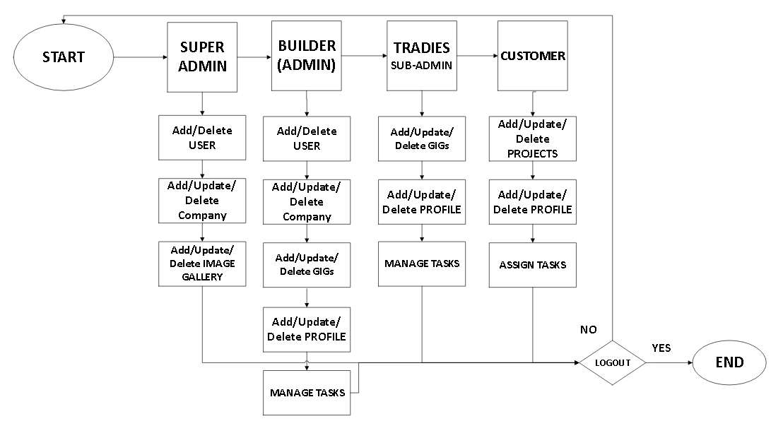
Work Flow Diagram

Slide 14
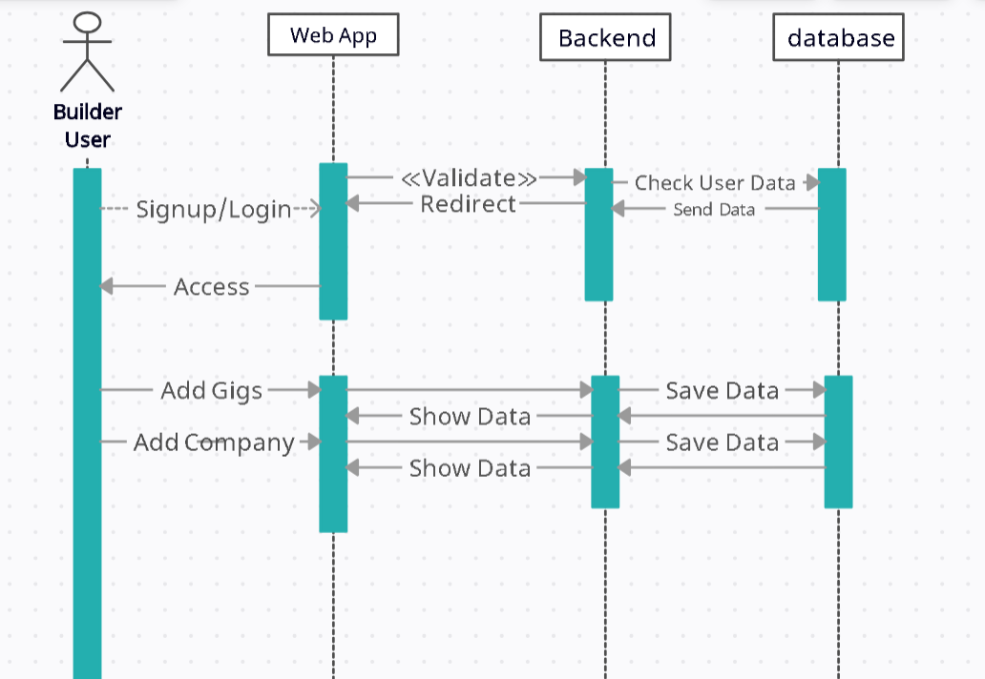
Sequence Diagram

Slide 15
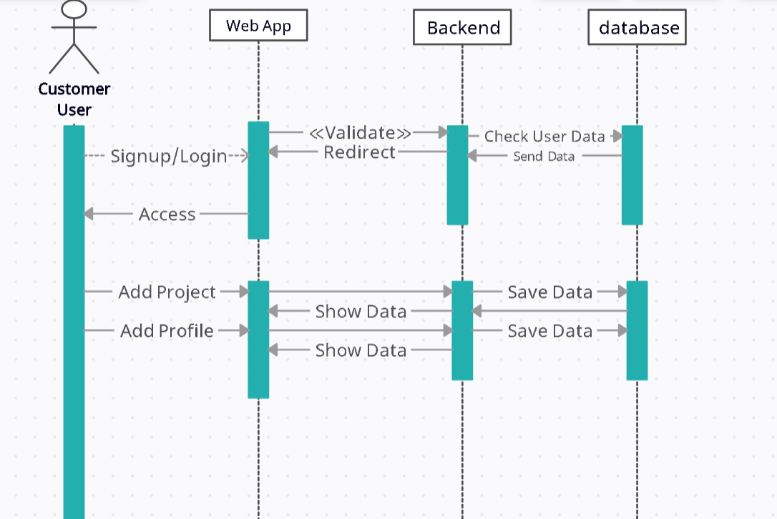
Sequence Diagram

Slide 16
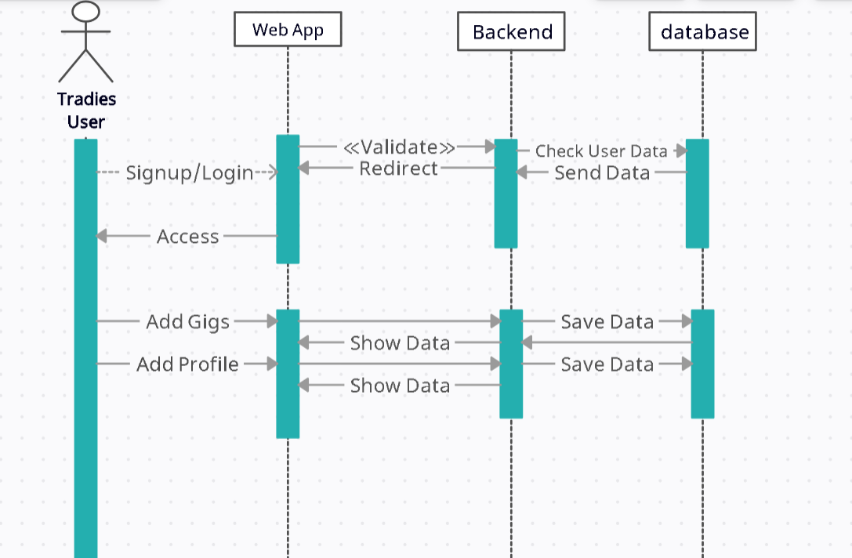
Sequence Diagram

Slide 17
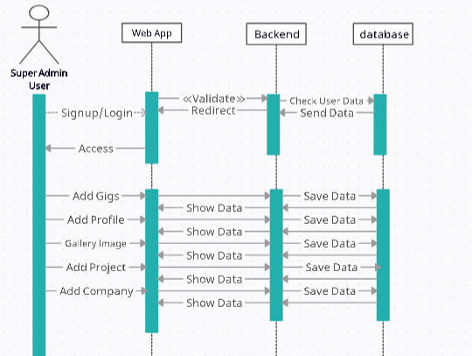
Sequence Diagram

Slide 18
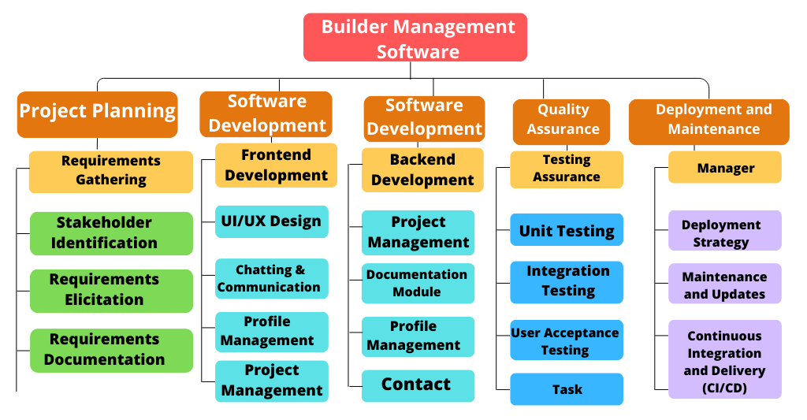
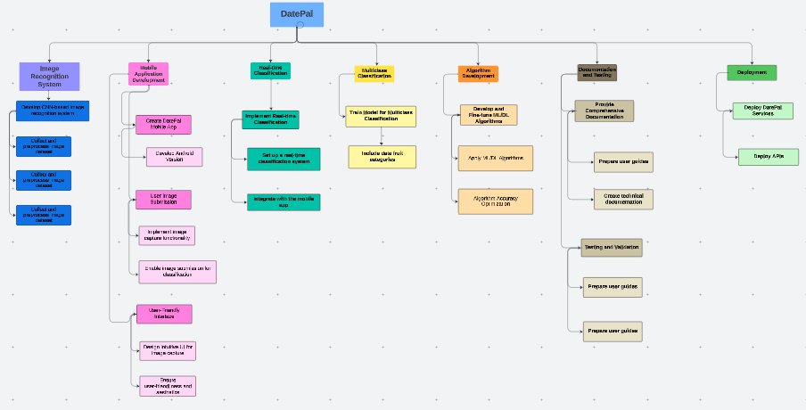
Work Breakdown Structure

Slide 19
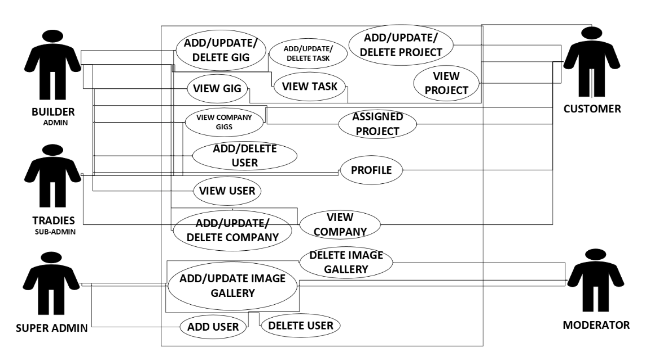
Use-Case Diagram

Slide 20
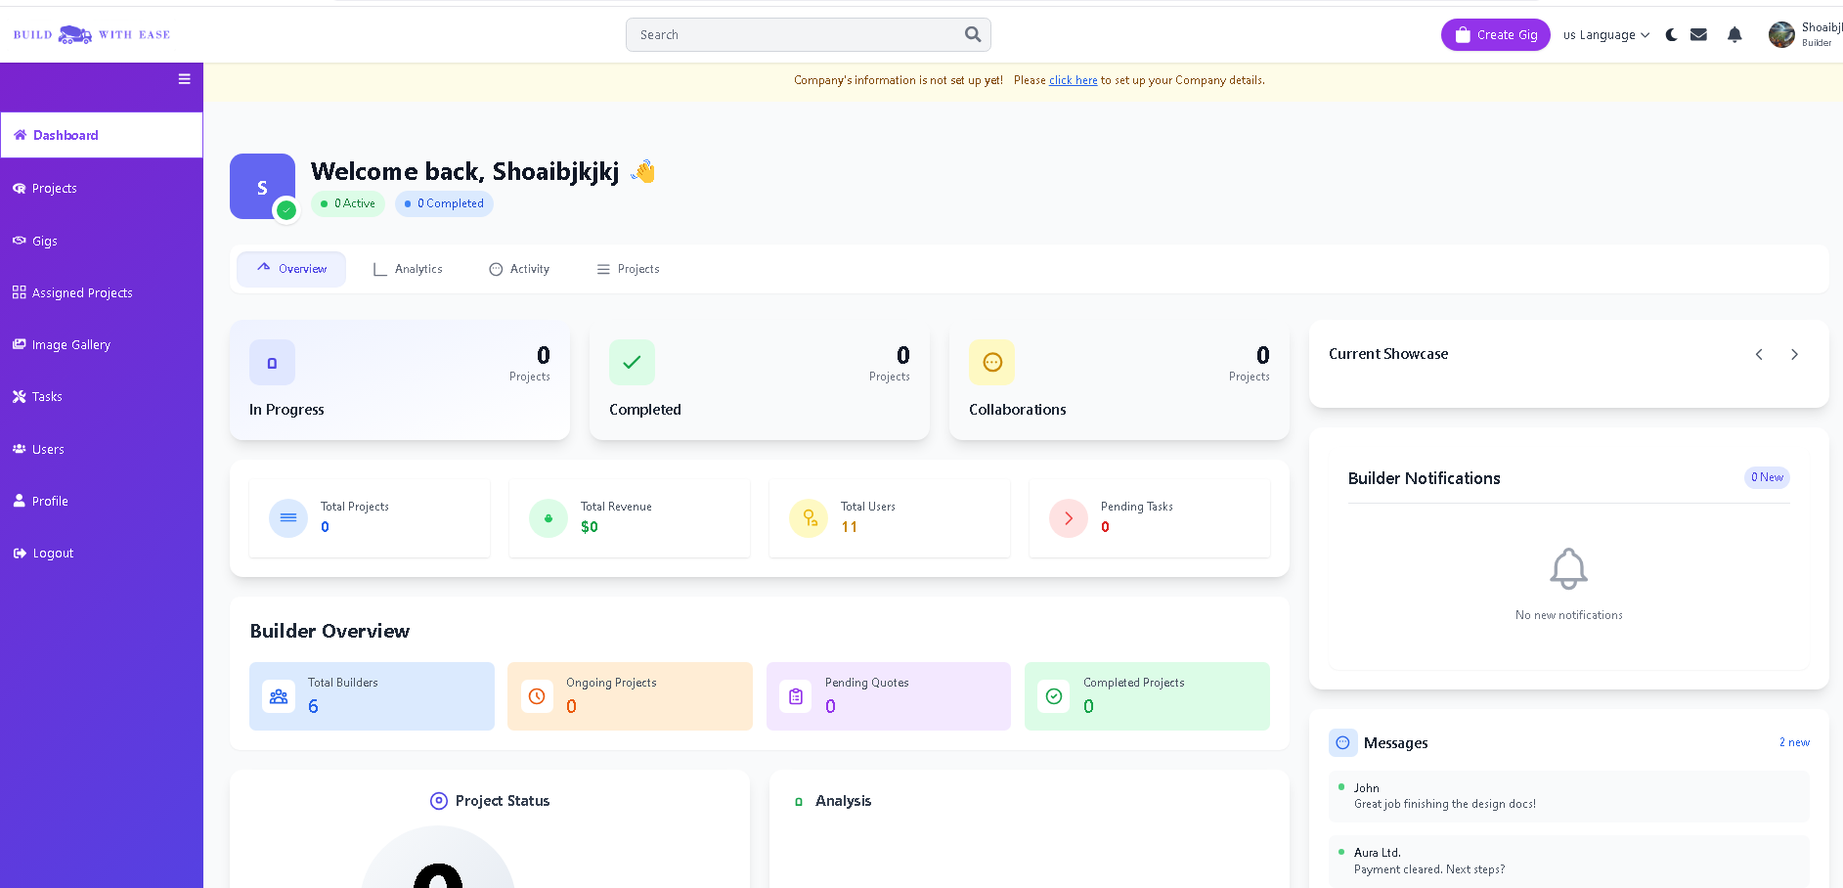
Prototype Designs (screen 1)

Slide 21
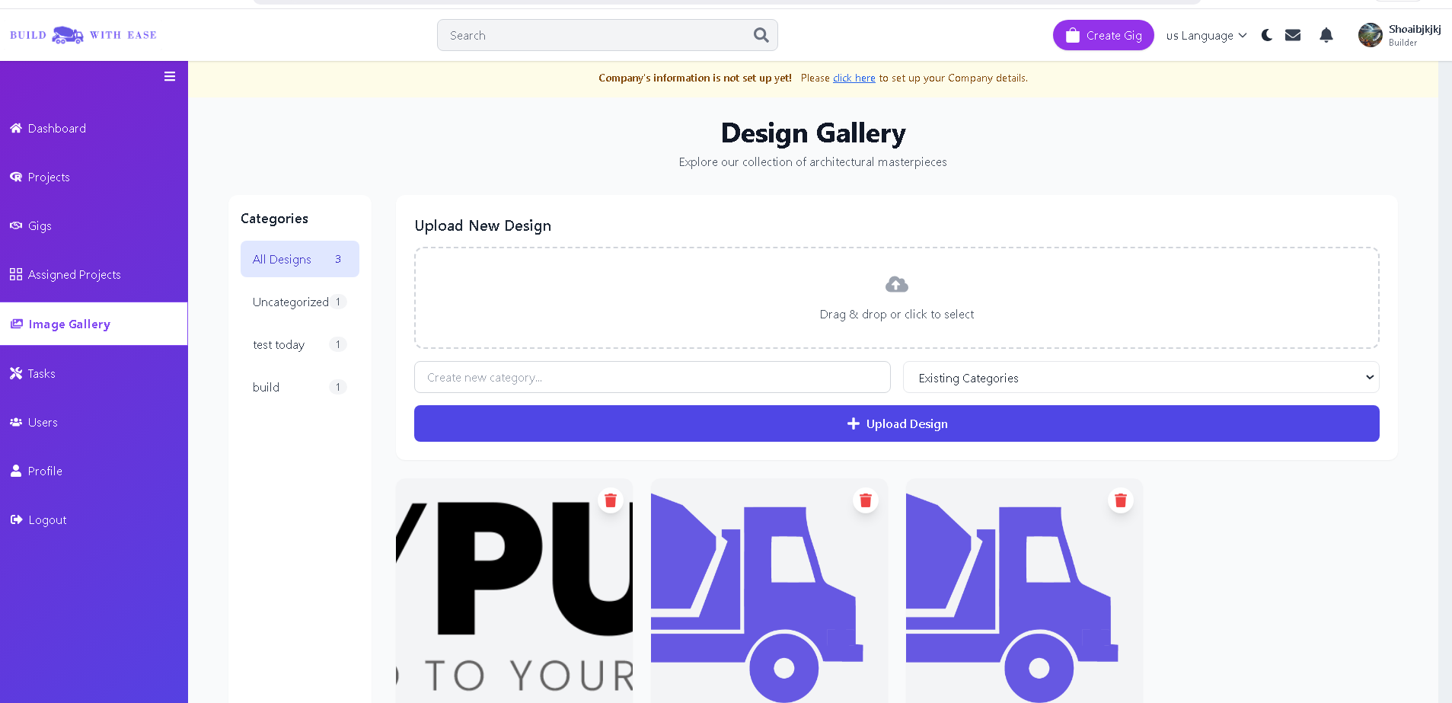
Screen 2

Slide 22
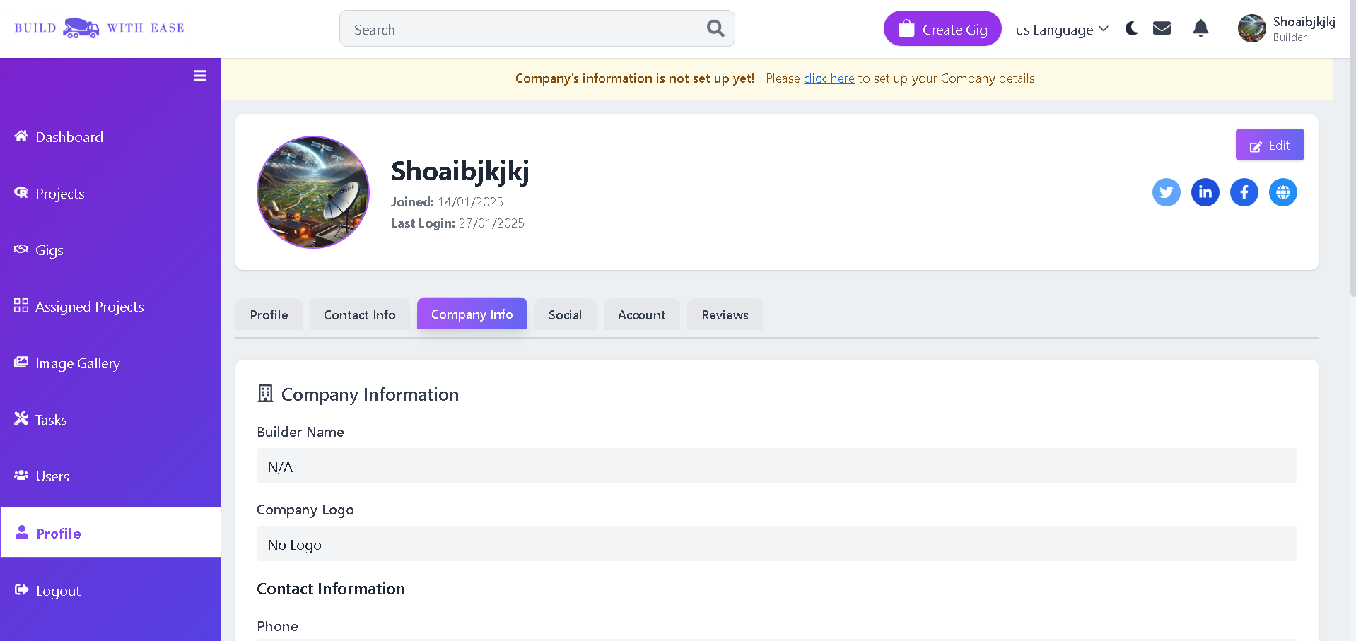
Screen 3

Slide 23
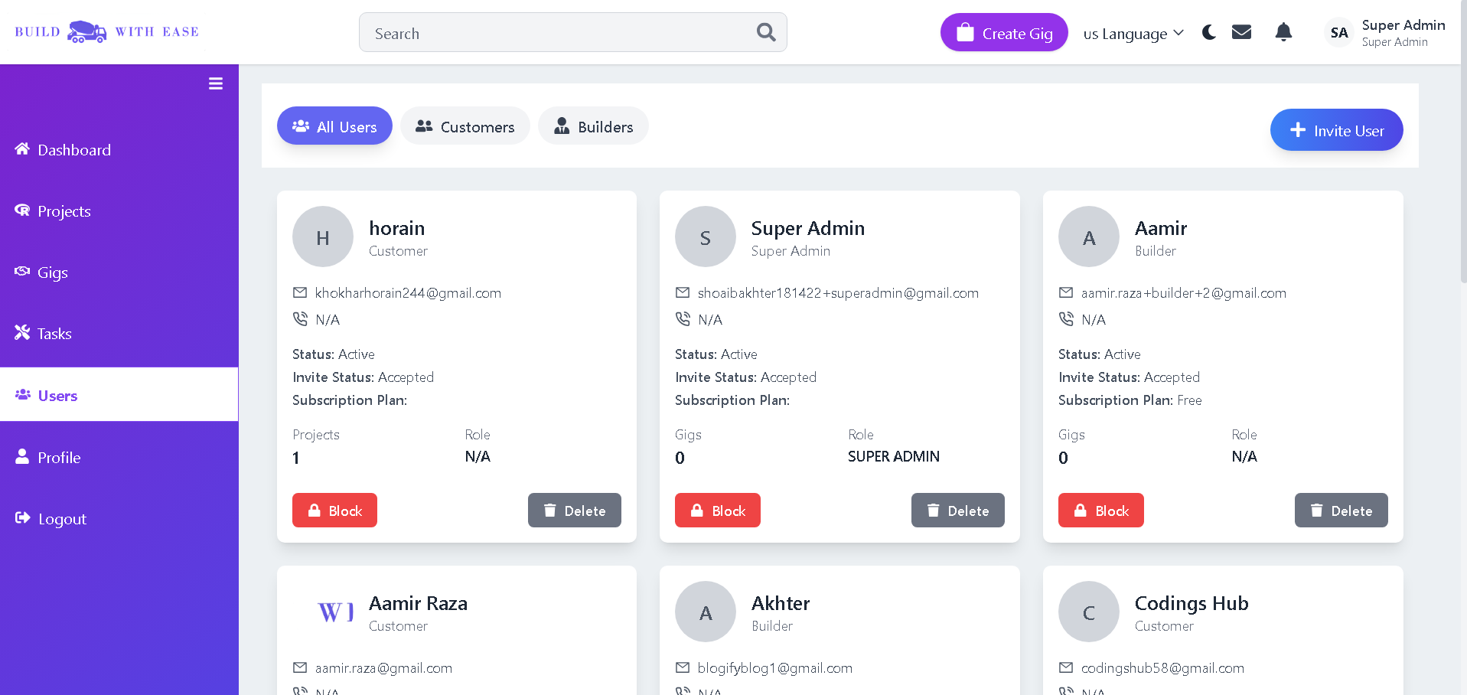
Screen 4

Slide 24
References
BuildTools: Project management software for construction professionals to streamline workflow.
https://www.buildtools.com/
Procore: Comprehensive construction management platform for enhancing project efficiency and collaboration.
https://www.procore.com/
CoConstruct: Software for builders and remodelers to manage projects, clients, and communications.
https://www.coconstruct.com/

Slide 25
Thank You

